Slide 1

A Practical Starter Guide to SQL Notebooks
Deborah Melkin
SQL Saturday Albany
July 25, 2020

Slide 2
I really want to learn how to use SQL Notebooks but I don’t have time to figure it out at work either.
So let’s figure out how to do this stuff together.

Slide 3








Explore your PASS community
Own your career with interactive learning built by community and guided by data experts.
Get involved. Get ahead.
Free online webinar events
Local user groups around the world
Connect with the global data community
.org
Online special interest user groups
Learning on-demand and delivered to you
Get involved

Slide 4

Missed PASS Summit 2019?
Get the Recordings
Download all PASS Summit sessions on Data Management, Analytics, or Architecture for only $399 USD
More options available at PASSstuff.com

Slide 5

We are covering all bases to ensure our community can continue reaching new and exciting heights. Plans are underway for the in-person event you all know and love along with a new venture, a new opportunity: a PASS Summit 2020 Virtual Event.
Find out more at PASS.org/summit

Slide 6





Thank you to our Global Sponsors and Supporters

Slide 7
This event was sponsored by Microsoft Learn more about SQL Server 2019 today: -Get free training: aka.ms/sqlworkshops -Download the SQL19 eBook: aka.ms/sql19_ebook

Slide 8


Who Am I?
20 years as a DBA
Mainly work with SQL Server
Mainly work with OLTP but have worked with some data marts.
NESQL Board Member
SQL Saturday\User Group Speaker
IDERA ACE Class of 2020
Speaker Idol Winner 2019
Random facts:
I’m the alto section leader in my choir.
I go to bluegrass jams regularly.
I’ve been learning guitar and now mandolin.
I am a bit of a musical theater geek.

Slide 9
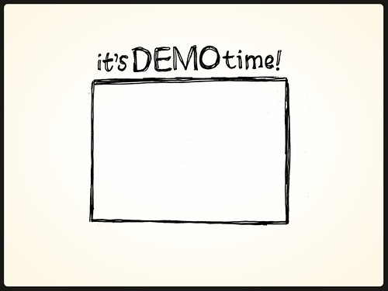
Agenda
Get to know the SQL Notebook interface
Use Cases
Troubleshooting Cheat Sheet
Development Testing Procedures
Interaction with SSMS
Using Notebooks Available to the Community
This Photo by Unknown Author is licensed under CC BY-NC-ND
Notes:
If there is time, invoke-sqlnotebooks module

Slide 10
Before we continue - Did we check in our code???

Slide 11
Advantages of SQL Notebooks
Documentation
Collaboration
Ability to save results with the queries
Multiple options for saving results
Can use the same tool for multiple kernels
Can be run by PowerShell and otherwise automated.

Slide 12
Limitations of SQL Notebooks
1 Kernel Per Notebook – Either SQL or PowerShell or Python, etc.
No Showplan for the query
NOTE: You can do this in Azure Data Studio but not in the Notebook cell
PowerShell can’t be run as an Adminstrator
Adjustment to a new tool

Slide 13
References
https://github.com/microsoft/azuredatastudio
https://github.com/microsoft/azuredatastudio/tree/main/samples
https://glennsqlperformance.com/resources/
http://sqlvariant.com/2019/09/automate-your-sql-notebooks-with-two-new-options/
https://github.com/sqlcollaborative/ADSNotebook
https://github.com/microsoft/sql-server-samples/tree/master/samples/features/sql2019notebooks
SQLCommunity Slack: #azure-data-studio
Twitter: @AzureDataStudio

Slide 14



Any Other Questions?
Email: dgmelkin@gmail.com
Twitter: @dgmelkin
Blog: DebtheDBA.wordpress.com
Github:
Session: https://tinyurl.com/y58p86sw
DB Scripts: https://tinyurl.com/y63ek8k9

Slide 15

Thanks for Coming!!!

